Slide 1
Agenda
What should we know before using angular
Brief about JavaScript framework
What is angular
Amazing features of angular
Why we need angular
Angular architecture
Angular Pros and cons
Angular Restrictions
Break for 10 min
Brief of JavaScript Design Pattern
Brief of Object oriented JavaScript
Angular Demo
Notes:
By the end of this Session you will be able to understand about angularJS.

Slide 2
What should we know before using angular
Moderate knowledge of HTML, CSS, JavaScript, including the following concepts:
Design Pattern
OOP, including encapsulation and inheritance
Object creation, prototypes
Basic Model-View-Controller concepts
The Document Object Model
JavaScript functions, events, error handling

Slide 3
JavaScript framework
A JavaScript framework or library is a set of utilities and predefined functions that make to develop application much easier and produce cross-browser compatible.
JavaScript frameworks make it easier to write code that, traverses, and manipulates DOM elements at run time.
Another important feature of JavaScript frameworks is its improved support for event handling.

Slide 4
Typical features of a JavaScript framework
Now, let's take a look at some of the useful features common to most JavaScript frameworks. These features are:
Selectors
DOM traversal
DOM manipulation
Utility functions
Event handling
Ajax

Slide 5
What is Angular
AngularJS is JavaScript MVC structured framework for dynamic web applications and allow you to developed well architectures and easily maintainable web-applications.
AngularJS allows you to extend HTML by adding your own custom tags and attributes.
Angular teaches the browser new syntax through a construct we call directives.
angularJS you need to write lesser code as It allows you to develop reuse components.
AngularJS Can bind data to any element in two way, means changing data will automatically change element and changing element will change the data..
You can control complete dom structure show/hide, changing everything with angularJS properties..
AngularJS provide All the features that you need to build a CRUD application like data-binding, data validation, url routing, reusable HTML components and most importantly dependency injection.
Notes:
AngularJS is an open-source JavaScript framework, maintained by Google, that assists with running single-page applications. Its goal is to augment browser-based applications with model–view–controller capability

Slide 6
Angular features
MVC capability
Two way data binding
Templates
Directives
Filter
Dependency Injection
Many More will discuss in details while develop web stuff
Notes:
A directive can be either a tag in HTML or an attribute of a tag. However directives are not tags/attributes defined by HTML standard. They are defined by us, the programmers. Even AngularJS defines a few directives for our use. So for e.g. I can define my own directive <table2by3> and its behaviour as well. The the best part is that I can reuse this directive whenever needed. The concept sounds interesting but the question is how does the browser understands user defined tags or attributes. Well the browser will not understand them at all however it will add them to the DOM tree it creates. AngularJS awaits the moment the DOM tree is created in the browser, finds out angular specific DOM nodes and processes them. This process is part of a bigger process called as bootstrapping an application.

Slide 7
Utility Directives provided by Angular
ng-non-bindable: Angular does not consider content inside {{ }} as part of an expression
ng-init: Initialize model variables in HTML
ng-click: Write expressions in HTML for onClick on various HTML elements
ng-disabled: Conditionally disable an item using Angular Expressions
ng-repeat: Use for loop in HTML to generate multiple elements
ng-class: Write expressions in HTML to conditionally apply CSS
ng-src: Write image tags <img> with dynamic links in HTML
ng-switch: Switch case in HTML to render HTML elements conditionally
ng-view
ng-include
ng-form
ng-transclude
ng-options
ng-csp

Slide 8
Why Angular ?
MVC Support
Two way data binding
AngularJS Supports Single Page Applications.
AngularJS Helps Developers Manage State.
AngularJS Gives Developers Controls.
AngularJS Enables Massively Parallel Development.
AngularJS Handles Dependencies
Routing Mechanism.

Slide 9
Angular Architecture
See Demo Application
Notes:
One very important directive defined by AngularJS is called ng-app. The 1st step AngularJS does after it gets callback forDOMContentLoaded is that it looks for the ng-app directive. We have discussed above that directive can either be a tag or an attribute.ng-app can only be used as an attribute. AngularJS expects users to use ng-app only once per application. It ignores all other declarations of ng-app if used.

Slide 10
Pros and cons
MVC capability: AngularJS does not require writing lengthy codes to connect the MVC components of split apps, which saves oodles of time and effort. Just split the app and let Angular do the rest for you by managing the components and also connecting them all by itself.
Two-way data binding: AngularJS comes with this great feature which reduces writing codes substantially. Data binding tries to get rid of writing codes manually by relieving the backend server from creating templates. MVC pipeline is also maintained by the framework itself.
Directives: Angular Directives add more functionality to the simple HTML. Directives help to enable the developer to specify custom and reusable HTML tags that change the behavior of some elements. Some directives featured in AngularJS are ng-app, ng-bind, ng-controller, ng-switch, ng-view, etc.
DOM manipulations: AngularJS keeps DOM manipulation codes inside the directives and not in the view. This augments in generating a clean and clear user interface.

Slide 11
Pros and cons
AngularJS is not all perfect. A couple of not-so-great aspects of AngularJS are:
Difficult to adapt the existing code: AngularJS requires the developer to re-implement the entire transformation code which makes it extremely hard to play around while adapting existing code.
Too heavy: AngularJS is a bulky framework that might be a good option to build large applications. But in case of simpler requirements of data binding, it can get a little too much to deal with and could confuse you with an excess of functionality that might be totally useless. Lighter frameworks like KnockoutJS or BackboneJS might be a better option in such a situation.

Slide 12

Angular JS is MVC
MVC = Model-View-Controller
Less dependencies
Improves maintainability
It is easier to read and understand code
A model part of application also called View Model or $scope is the term use in AngularJS for it and a really important part of Angular.
View Controller and Scope(Model)

Slide 13
M for Model
In AngularJS a model is a property of the $scope object
It is the actual link between Controllers and Views
Holds the data & method
Notifies the View and the Controller for changes in the data
Model represents the current state of the view

Slide 14
V for View
it is the way to show the data to users. View uses the directives, filters and data-bindings.
In AngularJS world the definition of a view has not changed, it is still the HTML content
Displays stuff (buttons, labels, …)
This is what your users will see
Knows about the Model
Usually displays something related to the current state of the Model

Slide 15
C for Controller
A controller in AngularJS is a JavaScript function. The controller function is defined by application programmers/us and is automatically called by AngularJS whenever the HTML(view) is loaded in the DOM tree.
We put all of our logic to container called controller in Angular. Controller control and prepare the data into the form so it can be rendered at View.
Controller actually transforms the bunch of data into the representable form and also take from view and set into the Model after validating it.
The controller is responsible for communicating server code also it fetches the data from Server using Ajax calls and send the data to back-end server from Views.

Slide 16
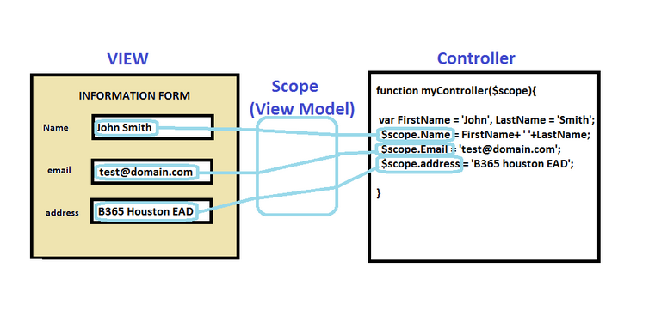

Slide 17
Design Pattern
Demo

Slide 18
Object oriented JS
Demo

Slide 19
Angular JS
Demo

